Slide 1

Sprocket Central Pty Ltd
Data analytics approach
[Division Name] - [Engagement Manager], [Senior Consultant], [Junior Consultant]

Slide 2
Agenda
Introduction
Data Exploration
Model Development
Interpretation

Slide 3
Introduction
Identifying & recommending high value customers
The problem
Data insights
Targeting high value customers based on customer demographics and attributes.
Sprocket Central Pty Ltd sells high value bikes.
The marketing team wants to improve the profits.
Sprocket Central Pty Ltd has provided a new list of 1000 potential customers which of these new customers should be targeted to drive the most value for the organisation.
Bikes purchases for the last 3 years by gender.
wealth segments by age.
states by number of owned cars.
industry bike related purchase.
Customer classifications.

Slide 4
Data Exploration
Data Quality Assessment
Transactions dataset:
Accuracy: missing values for[profit].
Completeness: in complete values [customer id – brand – product line – product class – product price].
Validity: format for [list price – product sold date].
Customer Demographic:
Accuracy: [age - dob].
Completeness: [job title – customer id].
Consistency: [gender].
Currency: [deceased customer].
Relevancy: [default] removed.
Customer Address:
Completeness: [customer id].
Consistency: [states]

Slide 5
Data Exploration
Bikes past 3 years purchases
Females are higher than males by 1% for bikes purchases over the last 3 years.

Slide 6
Data Exploration
Industry bike related purchase
Only three industries has high profits.
Most of the industries are below the average $968,398 .
There is a direct relation between number of bikes sold and profit made.

Slide 7
Data Exploration
wealth segment by age.
As shown the 3 peaks are from the age of 40 - 50.
The mass customer makes the most profits for all the ages.

Slide 8
Data Exploration
states by number of owned cars.
VIC & QLD ‘ve the highest potential since they ‘ve a small portion of the owned cars unlike NSW has the double of their number together.
2305
5201
2022

Slide 9
Model Development
Customer classification – RFM analysis
I’ve divided the customers based on the RFM analysis into 3 groups, most of the customers are in the silver section.

Slide 10
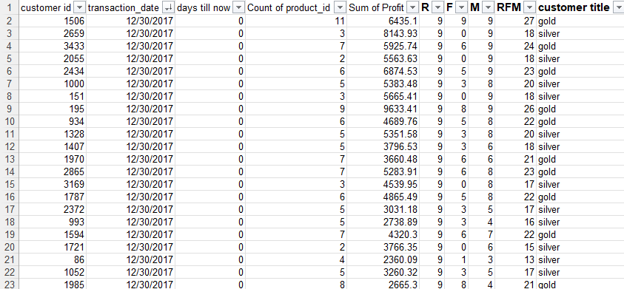
Interpretation
Customer classification – RFM analysis
The score is from 30 – 0. higher than 20 is gold, between 20 and 12 is silver, less than 12 is bronze.

Slide 11
Thank You

